Slide 1
STAT 308 Applied Regression
Chapters 5 – Chapters 7

Slide 2
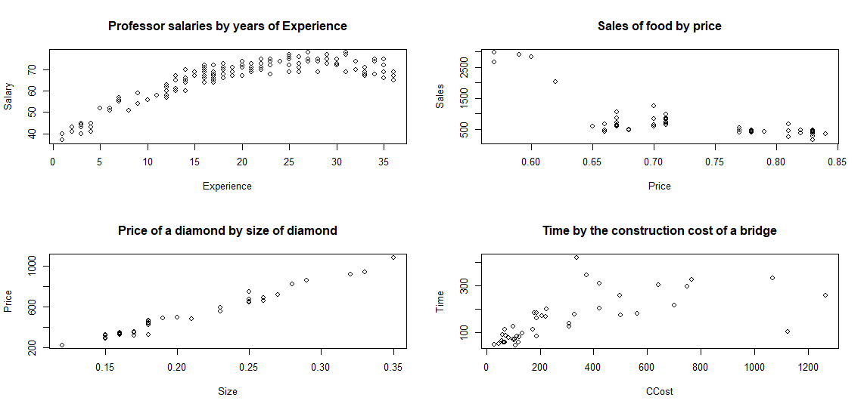
What mathematical function seems to fit the data of these graphs?

Slide 3
Linear Regression Process
Determine the form of the model from the sample – scatter plot.
Use the sample data to fit the model – determine parameters that need estimating and estimate.
Assess the assumptions of the model – make sure the model follows the rules of the method employed.
Assess the adequacy of the model – determine if the model is statistically useful.
Check if the form is correct – re-assess the eye-balled form from step 1 using better methods based on the model.
If satisfied with model, use it for prediction, estimation, analysis of trends, etc.

Slide 4
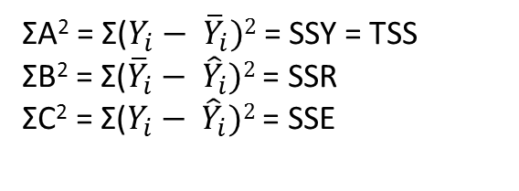
Regression Model and Error
y_{i}
C
A
B
B
y
A
C
y_{i}
x
ΣA² = Σ($Y_{i}− {\overline{Y}}_{i})2$ = SSY = TSS
ΣB² = Σ(${\overline{Y}}_{i}− {\hat{Y}}_{i})2$ = SSR
ΣC² = Σ($Y_{i}− {\hat{Y}}_{i})2$ = SSE

Slide 5
Properties of Least Squares Method
The sum of the residuals is 0
The sum of the squares of the residuals are minimized.

Slide 6
Example
The file ais.txt contains data on the athletes. There are 15 different variables. We are going to focus on predicting Height (in cm) by Weight (in kg). Later we will explore a multiple regression where we can include more than one predictor variable.
Step 1: Analyze the scatter plot to determine the form of the model and state the model.
Download the file from Sakai and create a scatter plot. Then, state the form of the model you choose.

Slide 7
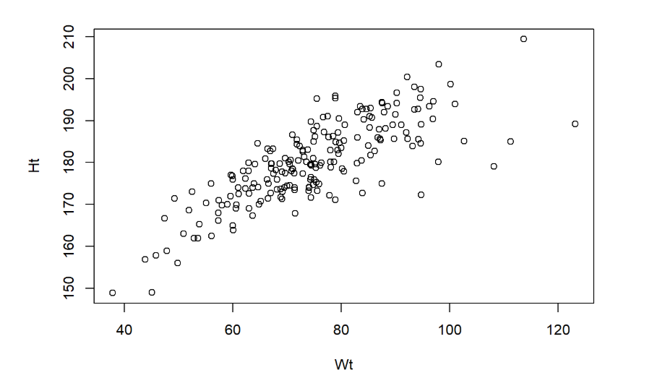
Scatter Plot

Slide 8
ANOVA Table from R
SSR - Sum of the squares of the Regressor
Analysis of Variance Table
Response: data1$Ht
Df Sum Sq Mean Sq F value Pr(>F)
data1$Wt 1 11615.0 11615.0 312.58 < 2.2e-16 ***
Residuals 200 7431.8 37.2
--- Signif. codes: 0 ‘***’ 0.001 ‘**’ 0.01 ‘*’ 0.05 ‘.’ 0.1 ‘ ’ 1
SSE - Sum of the squares of the Error (Residual)

Slide 9
Fit the Model and Assess Adequacy in R
Step 2: Fit the model
Use the lm command
fit = lm(y~x)
summary(fit)
Step 4: Assess the adequacy of model
1) Look at R-sq and Adjusted R-sq
2) Look at ANOVA table and assess SSE
3) Determine if the slope (and possibly the intercept) are statistically significant.

Slide 10
R Output of LSM
Step 2: Fit the model
Step 4: Assess the adequacy of model
fit = lm(y~x)
summary(fit)
Call: lm(formula = data1$Ht ~ data1$Wt)
Residuals:
Min 1Q Median 3Q Max
-19.1228 -3.9483 0.3683 4.6006 14.8276
Coefficients: Estimate Std. Error t value Pr(>|t|)
(Intercept) 139.15831 2.35533 59.08 <2e-16 ***
data1$Wt 0.54588 0.03088 17.68 <2e-16 ***
--- Signif. codes: 0 ‘***’ 0.001 ‘**’ 0.01 ‘*’ 0.05 ‘.’ 0.1 ‘ ’ 1
Residual standard error: 6.096 on 200 degrees of freedom
Multiple R-squared: 0.6098, Adjusted R-squared: 0.6079
F-statistic: 312.6 on 1 and 200 DF, p-value: < 2.2e-16
Sqrt(MSE)

Slide 11
Coefficients from R
fit1$coefficients[1] # intercept estimate
fit1$coefficients[2] #slope estimate
MSE and RMSE
sse = sum(fit1$residuals^2)
mse = sse/(length(fit1$residuals)-2)
mse
rmse = sqrt(mse)
rmse

Slide 12
Statistical Assumptions for Straight-line Model
Statistical Assumptions for straight-line model
Existence
Linearity
Independence
Normal Distribution
Equal (constant) variance of the distribution of y at any x.
Note: We will use residual plots to analyze assumptions 2 – 5. A helpful mnemonic for remembering these assumptions is LINE.

Slide 13
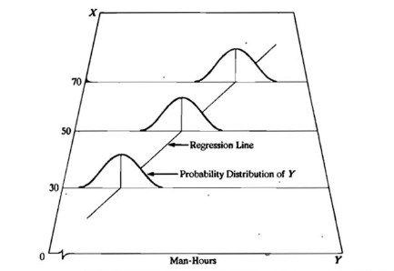
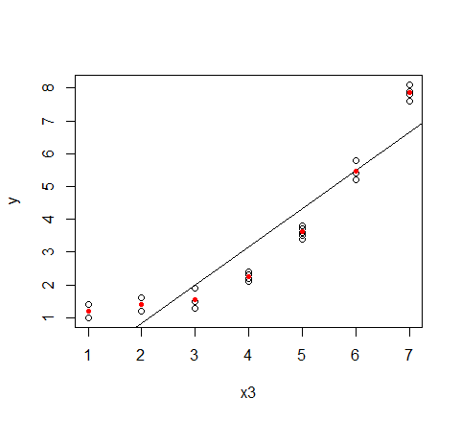
Linearity and Normal Assumption
The line must pass through the mean value of y at each x : µ_{Y|X}
The probability distribution around each Y value at a specific X value is normally distributed.
Note that the line does not pass through the estimated mean of each x. Therefore a straight-line model is NOT appropriate.

Slide 14
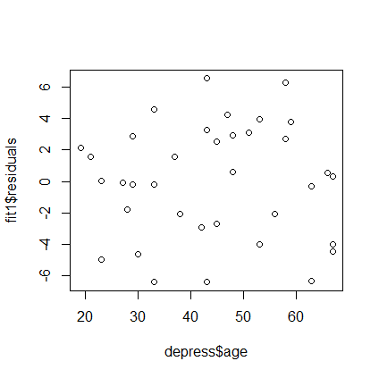
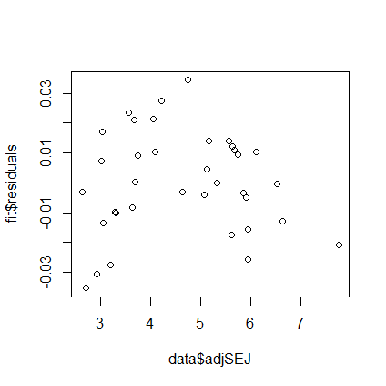
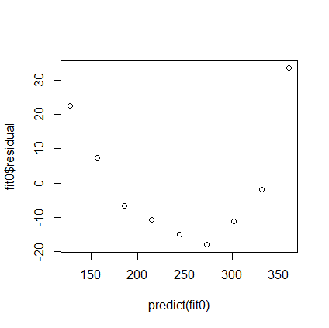
Linearity
Residuals are random and evenly distributed around 0. “Sneeze Test”
plot(fit$residual~x) or plot(fit$residual~predict(fit))
Groove vs Mileage
Linear:
Not Linear
Not Linear

Slide 15
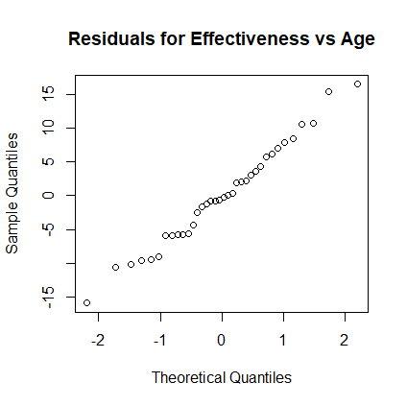
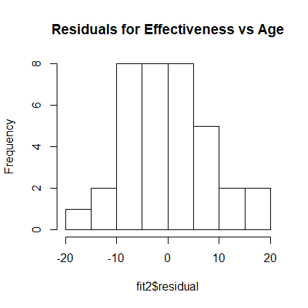
Normal Distribution of Residuals
Histograms or QQ Plot
Example of Residuals Normally Distributed
hist(fit0$residual) qqnorm(fit0$residual)

Slide 16
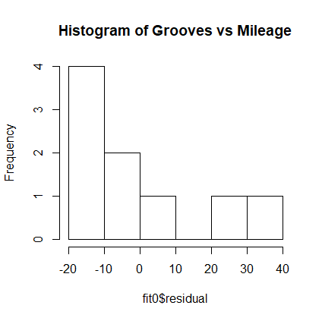
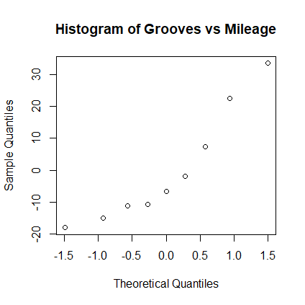
Normal Distribution of Residuals
Not Normally Distributed. Bad

Slide 17
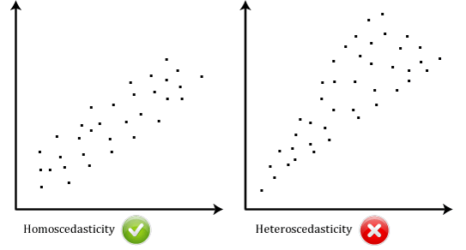
Equal/Constant Variance
Homoscedastic = equal or constant variance
Heteroscedastic = non-constant variance

Slide 18
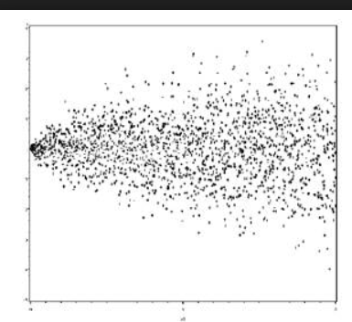
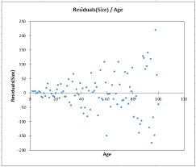
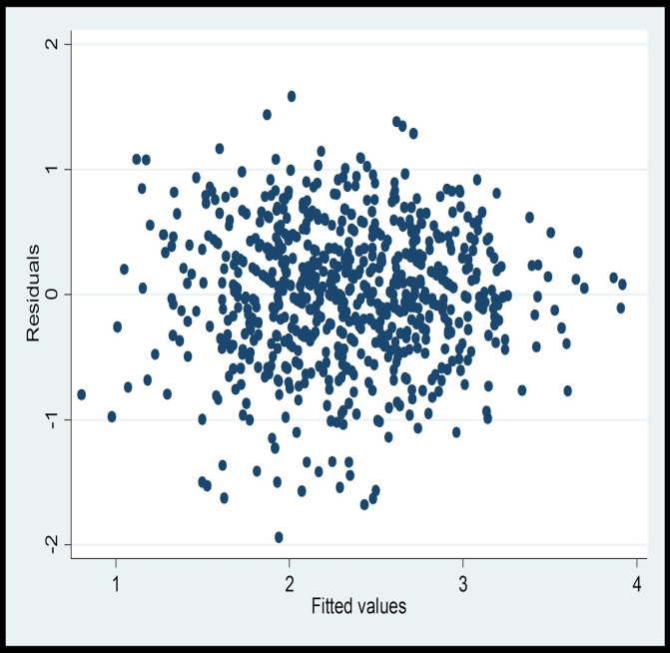
Fixing Issues of Hetroscedasticity
Try ln(y) transform Try sqrt(y) transform
If y is a rate or proportion
try arcsin(sqrt(y)) transform

Slide 19
Assessing the form of the model using residuals
Step 3: Assess the form of the model
1. The residuals in the residual vs. predicted plots are randomly distributed about ε = 0
2. No fanning or funneling in the residual vs. predicted (or x) plot
3. Residuals are normally distributed with mean 0.

Slide 20
Properties of a Well Behaved Residual Plot
The residuals "bounce randomly" around the 0 line. This suggests that the assumption that the relationship is linear is reasonable.
The residuals roughly form a "horizontal band" around the 0 line. This suggests that the variances of the error terms are equal.
No one residual "stands out" from the basic random pattern of residuals. This suggests that there are no outliers.
(https://newonlinecourses.science.psu.edu/stat462/node/117/)

Slide 21
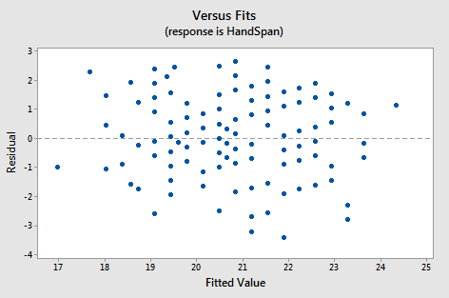
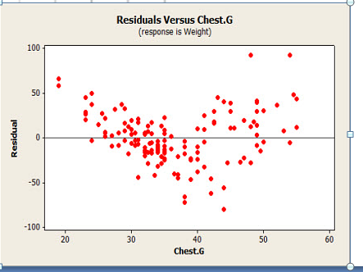
Properties of a Well Behaved Residual Plot
Good. Appears random and pretty evenly divided around 0. Does not appear to fan out. No apparent outliers.
Bad. There is a distinct pattern. There appears to be an issue of non-constant variance as the residuals appear to fan out as Chest.G gets larger.

Slide 22
Residual plots in r
fit = lm(y~x)
par(mfrow=c(2,2))
plot(fit) # gives a 4 panel output of the model. This one is okay
or
plot(fit$residual~predict(fit))
qqnorm(fit$residuals)
hist(fit$residuals)

Slide 23
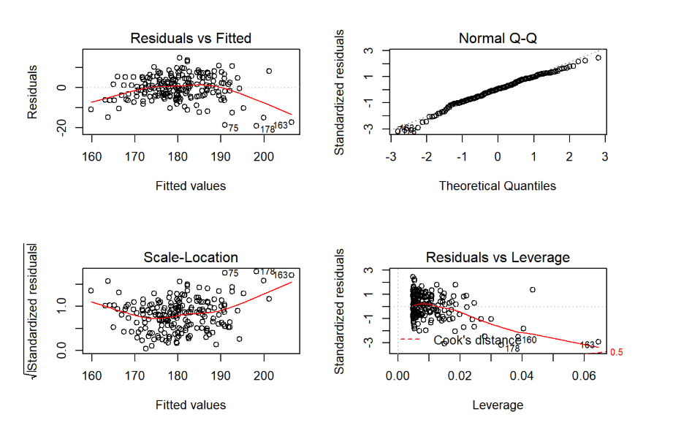
Residual Plots for AIS.txt

Slide 24
Example 1
Using R, open the file HomeDepot.csv. The file contains quarterly data on sales based on home starts (contractors starting to build a house). Create a linear regression for Sales(y) on Starts (x). Analyze the residual assumptions for this data.

Slide 25
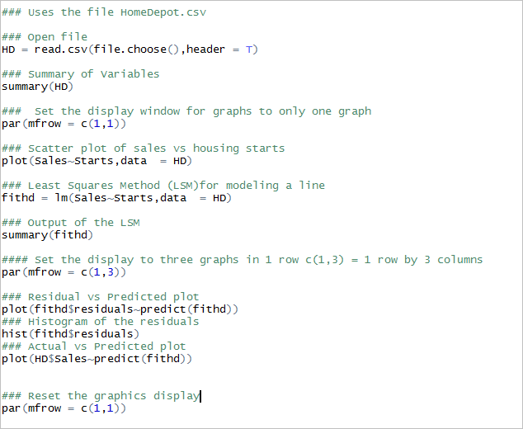
Example 1 Code

Slide 26
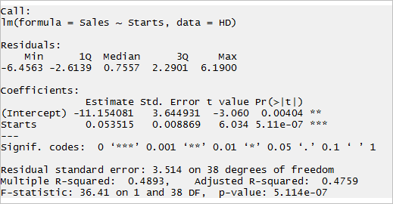
Example 1

Slide 27
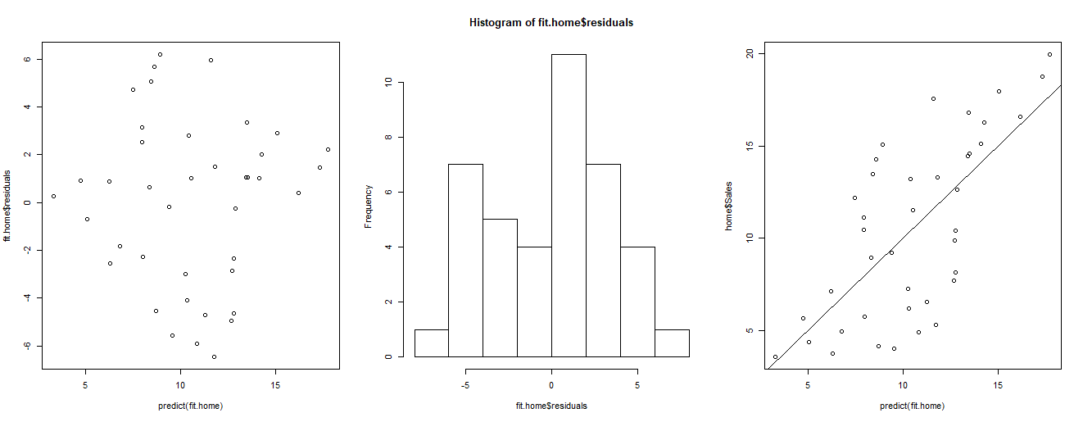
Example 1 - Home Depot

Slide 28
Example 2 - Tire Wear
The file tirewear.txt contains data on new tires. The pressure of each tire (press) and the mileage (mile) for that tire in thousands of miles is recorded in the file.
Plot mileage vs pressure. Does the data appear to be linear? What form does the data appear to be in?
Create the linear regression model. Analyze the output. Does the model seem adequate? (Test the slope parameter and analyze adj R^2)Use the plot(fit) command to generate the residual analysis plots
Create the model you think best fits the data and the residual plots. Does the model seem adequate?

Slide 29
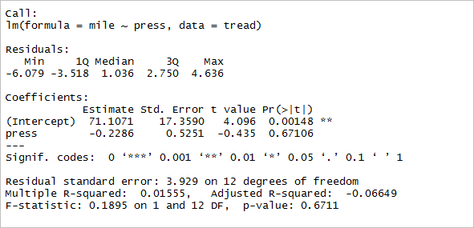
Example 2

Slide 30
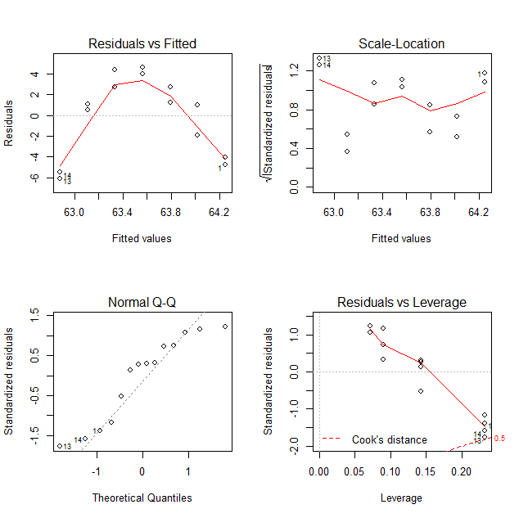
Example 2 - Tire Wear Linear Model
par(mfrow = c(2,2))
plot(fittread)
par(mfrow = c(1,1))

Slide 31
Example 2 – Tire Wear
Comparing scatter plot and residual plot

Slide 32
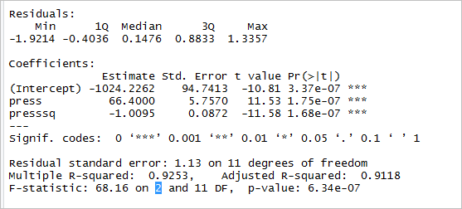

Example 2 – Tirewear using a Quadratic Model
$$Y=β_{0}+β_{1}x+β_{2}x^{2}+E$$
tread$presssq = (tread$press)^2
fittreadQ = lm(mile~press+presssq, data = tread)
summary(fittreadQ)

Slide 33
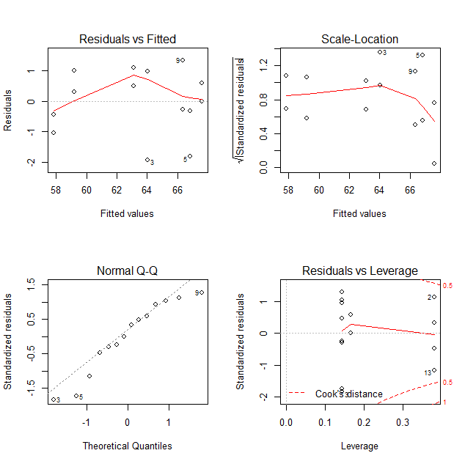
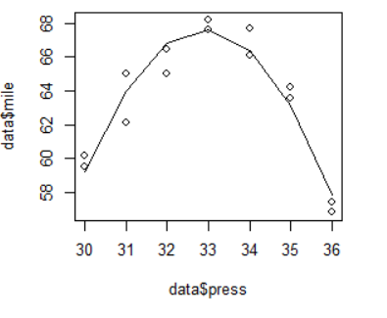
Example 2 - Tire Wear Quadratic Model

Slide 34
Example 2 – Quadratic Model

Slide 35
Example 3
The file Studying.txt contains data on the amount of time in minutes (min) students study for a quiz and the score they get on the quiz.
Plot score vs min. Does the data appear to be linear?
Create the linear regression model. Analyze the output. Does the model seem adequate?
Analyze the residual plots. Discuss whether you think this model is appropriate.

Slide 36
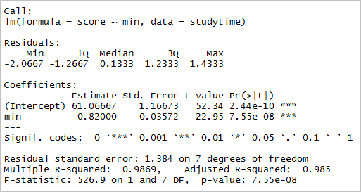
Example 3

Slide 37
Example 3

Slide 38
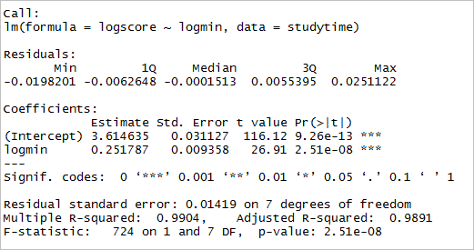
Example 3 – Power Model

Slide 39
Example 3- Power Model

Slide 40
Predict Command
We can use the predict command to
Determine predicted values
Find Confidence intervals of the line
Find Prediction intervals of the line
Syntax to predict the height of an athlete that weighs 65 kg.
myprediction = (ais.fit,data.frame(Wt = c(65)))
myprediction

Slide 41
Confidence Bands and Prediction Bands Code
plot(data1$Ht~data1$Wt)
#regression line
abline(lm(data1$Ht~data1$Wt))
newx = seq(min(data1$Wt),max(data1$Wt),length.out=100)
#plot of confidence bands
predsConf = predict(fit.ais,newdata = data.frame(Wt=newx),interval = “confidence”, level = 0.95)
lines(newx,predsConf[,2], lty =“solid”, col =“red”)
lines(newx,predsConf[,3], lty =“solid”, col =“red”)
#plot of prediction bands
predsPredict = predict(fit.ais,newdata = data.frame(Wt=newx),interval = “prediction”, level = 0.95)
lines(newx,predsConf[,2], lty =“dashed”, col =“blue”)
lines(newx,predsConf[,3], lty =“dashed”, col =“blue”)

Slide 42
Confidence and Prediction Intervals

Slide 43
Assessing r, the correlation coefficient
|r| | Strength of Correlation
0 | No Correlation
0.01 - 0.19 | Very Weak
0.20 - 0.39 | Weak
0.40 - 0.59 | Moderate
0.60 - 0.79 | Strong
0.80 - 0.99 | Very Strong
1 | Perfect Agreement

Slide 44



ANOVA Table
Source | df | SS | MS | F
Regression | k |  | MSR= SSR/df(R) | F=MSR/MSE
Residual/Error | n-k |  | MSE= SSE/df(E)
Total | n-1
$$SSR=\sum_{i=1}^{n}{{\left({\hat{Y}}_{i}−\overline{Y}\right)}^{2}}$$
$$SSE=\sum_{i=1}^{n}{{\left(Y_{i}−{\hat{Y}}_{i}\right)}^{2}}$$
$$TSS= \sum_{i=1}^{n}{{\left(Y_{i}−\overline{Y}\right)}^{2}}$$
k = number of predictor variables.
TSS = SSR + SSE
TSS = SSY
Total Unexplained Variation = Variation Due to Regression + Residual Variation after Regression

Slide 45
Regression Model and Error
y_{i}
C
A
B
B
y
A
C
y_{i}
x
ΣA² = Σ($Y_{i}− {\overline{Y}}_{i})2$ = SSY = TSS
ΣB² = Σ(${\overline{Y}}_{i}− {\hat{Y}}_{i})2$ = SSR
ΣC² = Σ($Y_{i}− {\hat{Y}}_{i})2$ = SSE

Slide 46
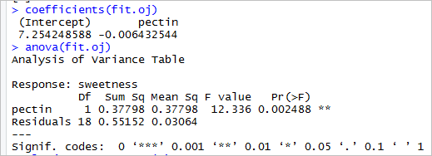
ANOVA Output
1. Find TSS
2. Find SSR/TSS

Slide 47
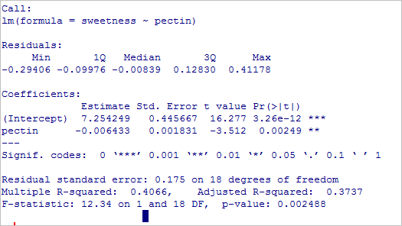
Regression Fit Output
Recall from previous slide F = 12.336 and p-val = 0.00249
Square the t value for pectin, what do you get?
Compare your answer to SSR/TSS to the R-squared value.

